Slide 1

Competitive Programming From Problem 2 Solution in O(1)
P
T
H
I
N
K
F
A
S
T
S
Introduction to Programming
Mostafa Saad Ibrahim
Teaching Assistant @ Cairo University

Slide 2
The big problem…
Students grow up = can’t code medium thinking problem
Students grow up = can’t code medium project
Problem: Much knowledge + Little Exercises

Slide 3
What is in? What is out?
This series is oriented for competitions
It covers only the basics needed for them
Series = Basic knowledge + Much Exercises
For competitions guys only? No
You Later: major book from A-Z

Slide 4
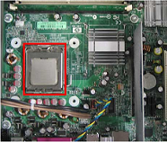
Computer Program?
Read Number 1 from user
Read Number 2 from user
Sum Them
If even Say YES, EVEN
Else Say So Bad
Computer + CPU
Computations +
Logical Decisions
Computer Program = Set of instructions
Image src: http://www.bbc.co.uk/schools/gcsebitesize/ict/images/processor.jpg

Slide 5
Programming Language
A way to talk to the computer (source code)
Many ones: C++, Java, C#...
Each language has pros and cons
C++ is a very popular start for programming

Slide 6





Learning Language States
Remember, new human language takes time
Programming Language is same
Struggle <= 2 months…then you admire it
Image sources in notes section
Notes:
http://cdn.mamamia.com.au/wp-content/uploads/2013/02/80472281.jpg
http://onefunnymotha.com/wp-content/uploads/2013/04/frustrated-guy-at-computer.jpg
http://3.bp.blogspot.com/-beAnqbrDx3g/TsYTAYSyHUI/AAAAAAAAC_E/QnL_YbBQmP8/s1600/ComputerFrustration.jpg
https://cdn.tutsplus.com/webdesign/uploads/2013/12/photodune-3007348-confused-boy-with-a-computer-s.jpg
http://assets.inhabitat.com/wp-content/blogs.dir/1/files/2012/07/boy-computer-537x357.jpg

Slide 7
Writing a Computer Program
Pick a language
Write Source Code (text) that follows language
Use compiler of language to convert code to what computer understands
Get an exe file..double click it (for windows)

Slide 8
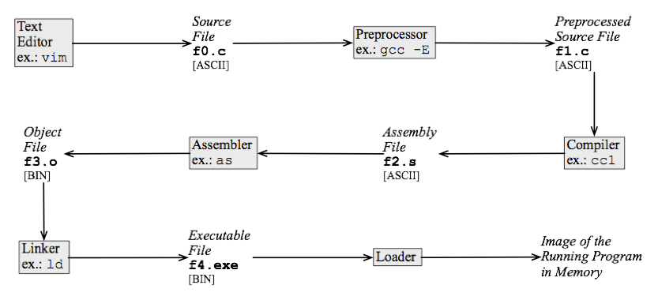
Source Code Life Cycle
To Learn more details about cycle: http://www.tenouk.com/ModuleW.html
Img Src: http://commons.wikimedia.org/wiki/File:Program_life_cycle_IPL.png

Slide 9
Our first Computer Program
Write a program that displays to user
My First Program. Hellllllo.
Use C++ Language

Slide 10
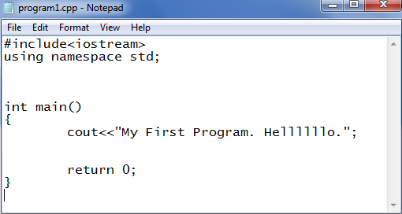
C++ Source Code Example

Slide 11
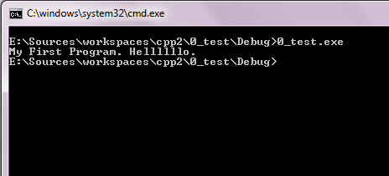
Compile and Run Exe

Slide 12
IDE: Integrated development environment
We could write the code in a notepad file, then go to compiler to compile and generate exe to run
What about something gathers all in simple way?
IDE = tools integrate staff for u
Many ones: CodeBlocks, Eclipse, C++Dev

Slide 13
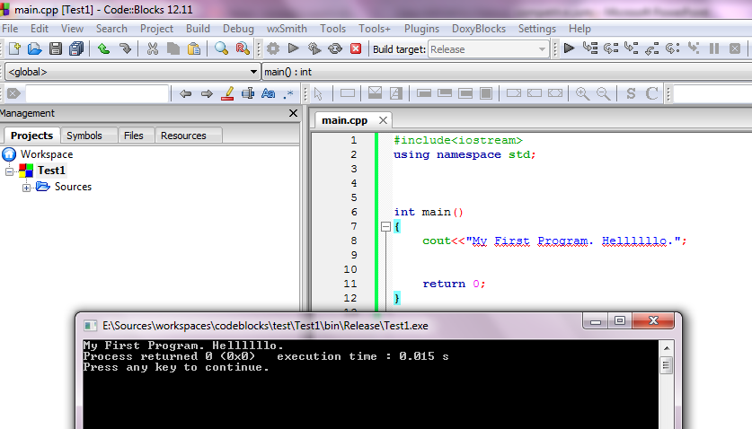
CodeBlocks IDE

Slide 14
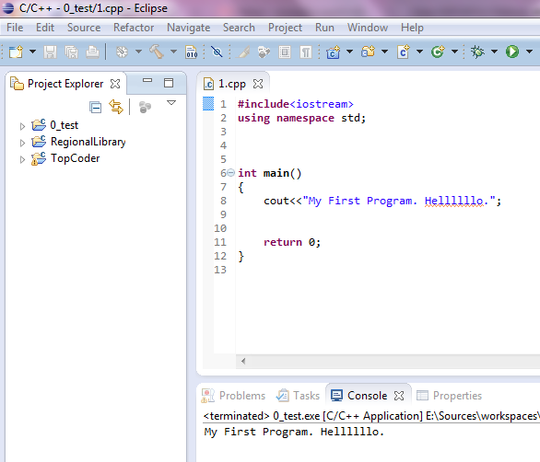
Eclipse IDE

Slide 15
Which IDE?
CodeBlocks is an easier start
Eclipse is more professional and many companies use it
Need little effort to start with it
I suggest it more
Note: Good programmer knows how to compile through command.

Slide 16
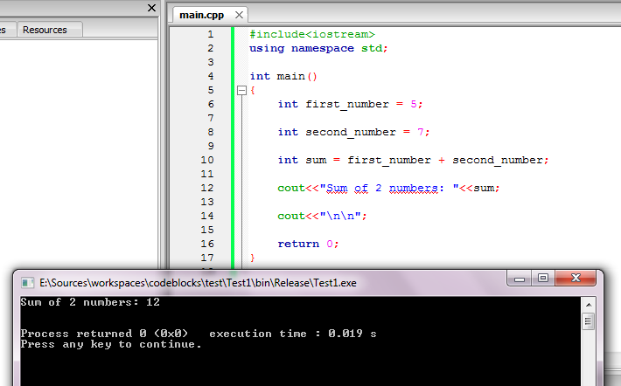
Summing 2 numbers Example

Slide 17
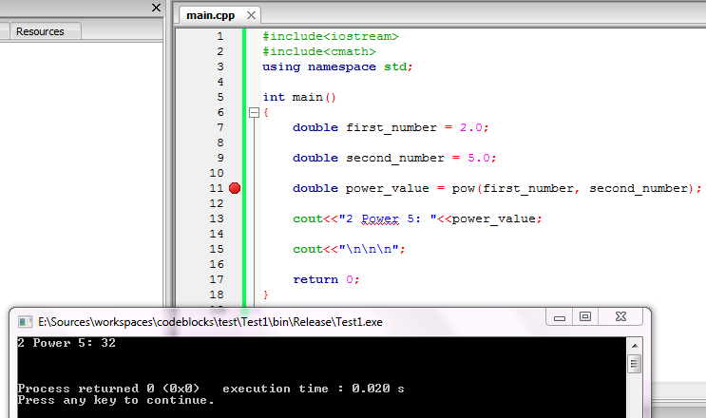
Powering 2 numbers Example

Slide 18
#include ??
Let say you want to find square root of 25, which is 5
One day you will write code to do it. But in real life, why let you write it from scratch!
There are some libraries ready for use to save your time. This is the #include part

Slide 19
#include <iostream>
Allows you to write to console
cout<<“Competitions";
This Display statement competition
cout<<“\n";
This Display an empty line
It also allows you to read from user
cin>>first_number
Reads number from user of the program

Slide 20
#include <Cmath>
This is where many math functions implemented for you
sqrt get square root
pow gets power of 2 numbers
sqrt and pow are called functions
and many other ones

Slide 21
Int main()
To run your code, Computer needs to know where is your code start
It searches for main()
Int refers to status of finishing.
Return 0; means code finished with no run time mistakes

Slide 22
int first_number = 5;
This line do following
Reserve memory blocks
Name it first_number
Set its value to 5
Int means integer. This is the type of memory reserved.
; => semicolon end of any statement in C++

Slide 23
Don’t worry
This is the first time to see source code
Most of it will be weird now
The more you see code…the more you get it

Slide 24
The magic fact: Write = Read
You could write Programs as much as what you read
Want to write long code? Read long ones
Want to write smart code? Read smart ones
You must read too much=> to write too much

